Slide 1

Minor Project Presentation
Project Title - Menstrubuddy
Team Members:- Apeksha Jain -21103081
Faculty Supervisor:-
Dr. Ankita Verma

Slide 2

Problem Statement:
Women Health victim of many prejudices and lack of helpful accurate tools.
Lack of awareness and access
Myths and misinformation
Limited tools
There are limited tools for accurate period tracking and PCOS prediction.
Many women lack awareness and access to reliable information on women's health.
There are prevalent myths and misinformation about menstrual health.

Slide 3



Solution:
Comprehensive Website
Helpful Features
A Supportive Community
We have developed a comprehensive website for fostering awareness regarding women health and provide females with a safe and healthy space.
The website includes features such as period tracking, PCOS prediction, exercise recommendations, government schemes, myth busters, data feedback, and a blog section.
We aim to create a supportive community where women can find accurate information and connect with others.

Slide 4

Features
PCOS Prediction
Period tracking
Myth Busters
Blogs Section
Feedback Form and data display
Physical Exercises Recommendations
Government Schemes Information
Contact Us information

Slide 5
Toolchain:
Web Frameworks
Database
We have used Flask (Python), Express.js, and Node.js as our web frameworks.
We have used MongoDB (NoSQL) as our database.
Machine Learning
Frontend
We have utilized Python libraries such as scikit-learn and pandas for machine learning.
The frontend of our website is built using HTML, CSS, and JavaScript (EJS for dynamic content rendering).
We have also used Google Forms for real-time data collection and collaboration.

Slide 6
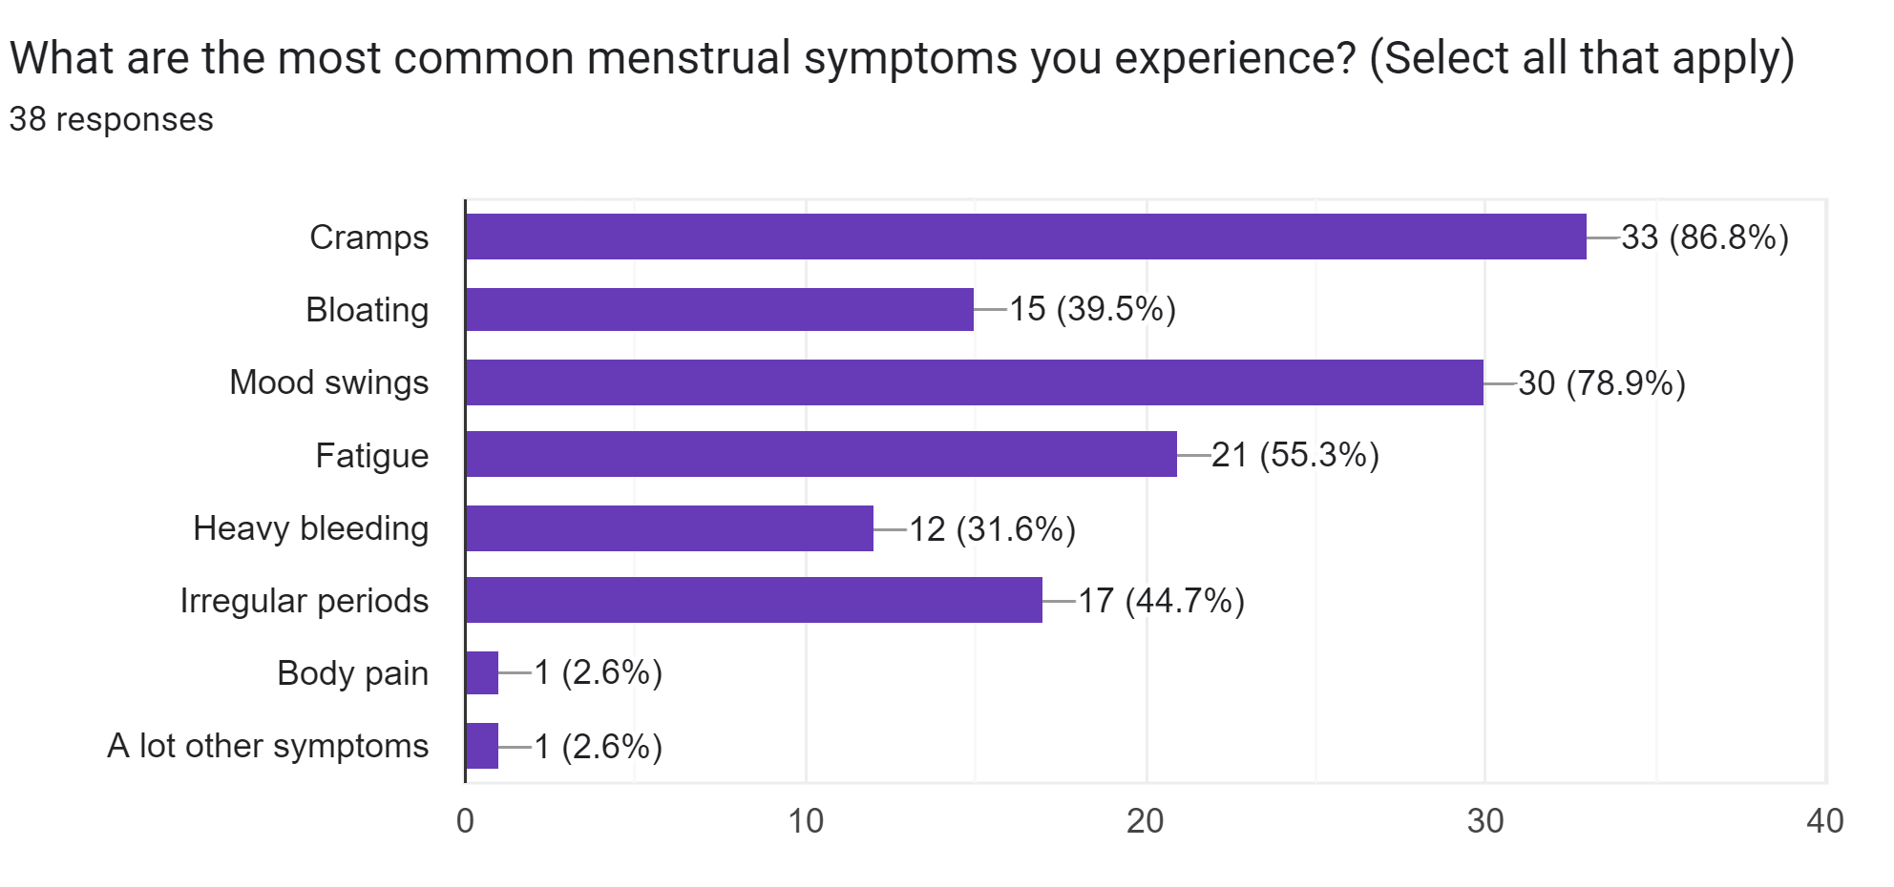
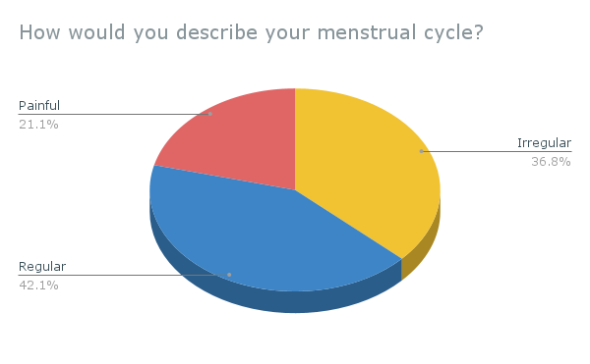
Survey and Real time Data Collection
We have also used Google Forms to conduct a survey on menstrual health questions and collected data from several females around us and gained some valuable insights.

Slide 7

Demo:

Slide 8
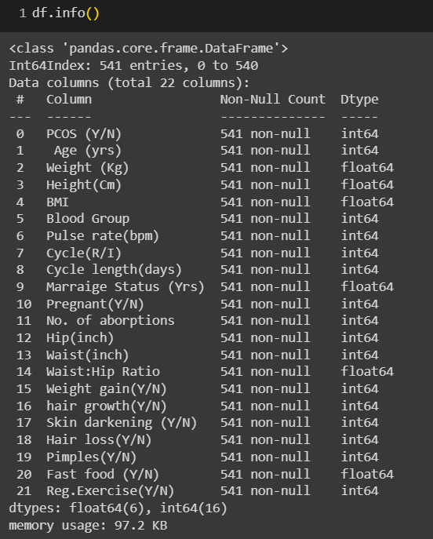
Dataset Overview
Kaggle dataset
The dataset consists of 541 PCOS feature description and results
This data is collected from 10 different hospitals across Kerala, India.
Total selected 22 features from 44 in total.
Use different techniques to predict the result on this data.

Slide 9
Machine Learning Algorithms (PCOS Prediction)
Logistic regression, Random Forest Regression and SVM are the three models used for comparative analysis and these are the final accuracy rates.
Model Name | Accuracy Score
Logistic Regression | 84%
Random Forest Regression | 79%
Support Vector Machine(SVM) | 67%

Slide 10

Learnings:
Acquisition of skills in Python, Flask, Express.js, Node.js, and MongoDB
Integration of machine learning into web development
User feedback and iterative development for user-centric design
Collaboration and division of work among team members

Slide 11
Challenges:
Technical Challenges
Data Collection
Machine Learning Model
Debugging
Finding an appropriate dataset and cleaning and feature selection for better user experience.
Fine-tuning for better accuracy
Ensuring smooth integration between frontend and backend and also integrating the model with node js app.

Slide 12

Future Scope:
Enhanced Features: Continuous improvement of period tracking and PCOS prediction algorithms
Community Engagement: Expand blog section, forums, and user interactions
Interactive OpenAI chatbot which will help you with your mood swings and give you health tips.
Global Language and Culture adaptation.

Slide 13
Conclusion:
Project Impact
Community Building
Technological Advancements
Our PCOS prediction model has achieved maximum 84% accuracy, empowering women with accurate period tracking.
We have fostered a supportive community through blogs and information sharing.
We have combined machine learning, web development, and data analysis for a holistic solution.

Slide 14
References:
H. Thakur, A. Aronsson, S. Bansode, C. S. Lundborg, S. Dalvie, and E. Faxelid, “Knowledge, Practices,
and Restrictions Related to Menstruation among Young Women from Low Socioeconomic Community in Mumbai, India,”
Frontiers in Public Health, vol. 2, Jul. 2014, doi: 10.3389/fpubh.2014.00072.
“PCOS Perception analysis prediction using Machine learning algorithms,” IEEE Conference Publication
| IEEE Xplore. https://ieeexplore.ieee.org/document/10054279.
Thakre, V. (2020). PCOcare: PCOS Detection and Prediction using Machine Learning Algorithms. Bioscience
Biotechnology Research Communications, 13(14), 240–244. https://doi.org/10.21786/bbrc/13.14/56
Omidvar, S., Amiri, F. N., Bakhtiari, A., & Begum, K. (2018). A study on menstruation of Indian adolescent girls
in an urban area of South India. Journal of Family Medicine and Primary Care, 7(4), 698. https://doi.org/10.4103/jfmpc.jfmpc_258_17

Slide 15
Thank You

